Slide 2
POST WORLD BLOG LAUNCH
APRIL – JULY
2017 IM Blog Metrics

Slide 3
Roughly 40% of IM’s employees are reading (conservative est.)
Direct and scroll (est.)
High interest topics:
GTM/regional changes, new hires, IN2, training
View glossary starting on slide 13
Takeaways
(Remember: There’s a mix of traffic to each blog—direct and scroll.
“Scroll” traffic cannot be counted accurately for each posting.
Instead, it’s seen via overall homepage and catalogue page visitation.)

Slide 4
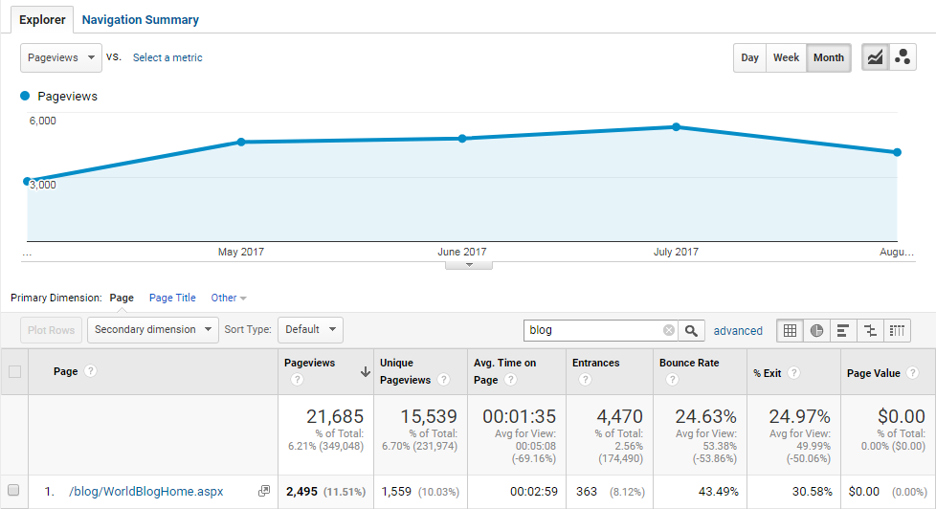
Overall Blog View, All Groups (Scroll Page)
  View glossary starting on slide 13

Slide 5
JULY’S TOP 5 MOST-READ BLOGS
(direct=unique visits/1 employee; no scroll count)
  HR/Announcing Elle Edwards as Global Head of Communication: (447 direct)
  IT/Windows 10 is here!: (329 direct)
  HR/Are you interested in development?: (315 direct)
  IM/Americas IM Service Region: (298 direct)
  IC/Our focus: Success from continued customer-centric transformation: (284 direct)
  View glossary starting on slide 13

Slide 7
JUNE’S TOP 5 MOST-READ BLOGS
(direct=unique visits/1 employee; no scroll count)
  HR/Five changes to your 401K plan: (546 direct)
  HR/Open positions in the US: (243 direct)
  HR/Time Reporting Reminder: (232 direct)
  IT/New Features in IT-KAre: (220 direct)
  IM/First ever IM e-learning modules!: (187 direct)
  View glossary starting on slide 13

Slide 9
MAY’S TOP 5 MOST-READ BLOGS
(direct=unique visits/1 employee; no scroll count)
  IT/Multi-factor authentication: (432 direct)
  HR/UW; retirement seminar; Open jobs: (305 direct)
  I-C/Capturing Disney with innovative digital photography: (214 direct)
  IT/Improve your KA Directory experience: (206 direct)
  IT/Office 365 Self-Help Improvements: (152 direct )
  View glossary starting on slide 13

Slide 11
APRIL’S TOP 5 MOST-READ BLOGS
(direct=unique visits/1 employee; no scroll count)
  IM/Welcome IM’s new Sales Director for APR, Leonel da Costa: (248 direct)
  HR/Project Ocean: The Future of Finance: (191 direct)
  IM/Taking Complexity Out of Info Capture: Introducing IN2 Ecosystem: (187 direct)
  IM/Sales GTM Transformation: Introducing the Americas Sales Org: (182 direct)
  IT/Updates from HR for US-based employees: (139 direct )
  View glossary starting on slide 13

Slide 13
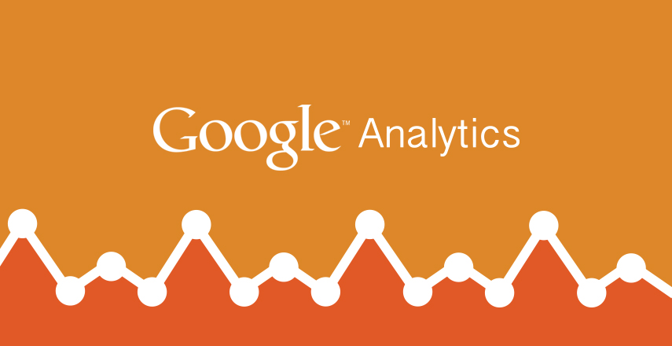
REFERENCE GLOSSARY

Slide 14
A pageview is defined as a view of a page on your site that is being tracked by the Analytics tracking code. If a user clicks reload after reaching the page, this is counted as an additional pageview. If a user navigates to a different page and then returns to the original page, a second pageview is recorded as well.
A unique pageview, as seen in the Content Overview report, aggregates pageviews that are generated by the same user during the same session. A unique pageview represents the number of sessions during which that page was viewed one or more times.
Pageviews vs. Unique Pageviews

Slide 15
Source: Every referral to a web site has an origin, or source. Possible sources include: “google” (the name of a search engine), “facebook.com” (the name of a referring site), “spring_newsletter” (the name of one of your newsletters), and “direct” (users that typed your URL directly into their browser, or who had bookmarked your site).
Medium: Every referral to a website also has a medium. Possible medium include: “organic” (unpaid search), “cpc” (cost per click, i.e. paid search), “referral” (referral), “email” (the name of a custom medium you have created), “none” (direct traffic has a medium of “none”).
Traffic Source Dimensions: Source & Medium

Slide 16
Direct:
In general, indicates visits where users navigated directly to the URL or the source of the visit is unknown; determined by a source of direct and medium of (not set) or (none)
2. Referral:
Indicates traffic where users clicked a link from another site, excluding major search engines; determined by medium of referral
3. Social:
Indicates visits from social networks (Facebook, Twitter, etc.)
Determined when Social Source Referral matches “yes;” Google Analytics also places these in the referral “bucket” matching a list of known social sources or when medium matches social, social-network, social-media, sm, social network, or social media
4. Organic Search:
Indicates visits from unpaid search results; determined by medium of “organic”
SOURCE: https://megalytic.com/blog/understanding-google-analytics-channels
Secondary Dimension Filter: Default Channel Grouping

Slide 17
Default.aspx
Its/sitepgages/default.htm – 246
(not set) – 121
/blogpost.aspx?ID=181 – 23
Intranet04/sitePages/home.htm – 23
Intranet02 – 14
/worldBlogHome – 10
Examples of Direct/Sources on World Blog
(Google Analytics Dashboard/Channels June 21 – 27, 2017)

Slide 18
MS Online
KA SharePoint
Learning Library
Yammer
Bring/Organic
MSN/Referral
Alarisoneclick.com
Mysalesforce.com
Yahoo/Organic
Examples of Referrals/Medium on World Blog
(from Google Analytics, descending rank)

